Slide 1
Swift/T High Performance Workflow Language
Justin M Wozniak
wozniak@mcs.anl.gov

Slide 2
Goal: Programmability for large scale computing
Our solution is “many-task” computing: higher-level applications composed of many run-to-completion tasks: input→compute→output Message passing is handled by our implementation details
Programmability
Large number of applications have this natural structure at upper levels: Parameter studies, ensembles, Monte Carlo, branch-and-bound, stochastic programming, UQ
Coupling extreme-scale applications to preprocessing, analysis, and visualization
Data-driven computing
Dataflow-based execution models
Data organization tools in the programming languages
Challenges
Load balancing, data movement, expressibility

Slide 3
Swift/T OVERVIEW

Slide 4
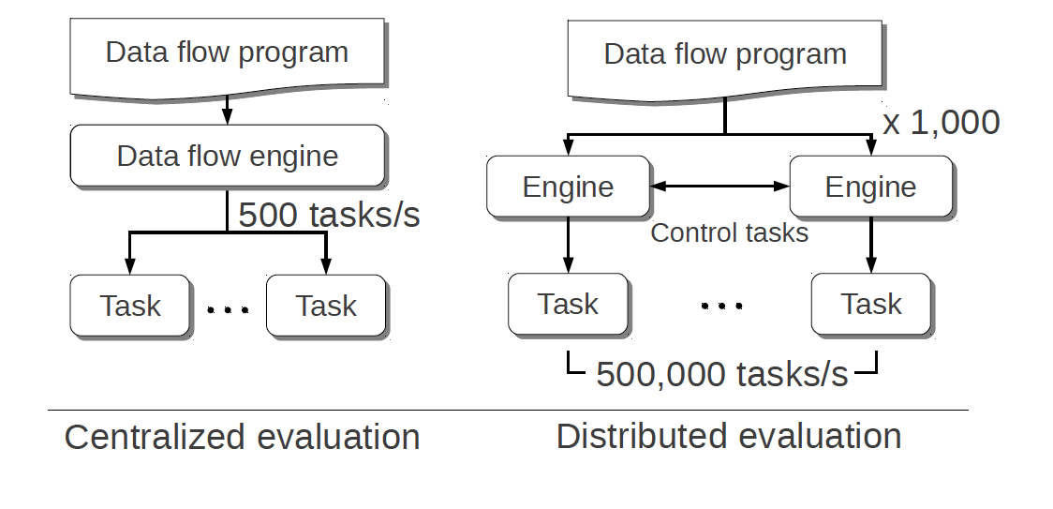
Swift/T: Swift for high-performance computing
Had this:
(Swift/K)
For extreme scale, we need this: (Swift/T)

Slide 5

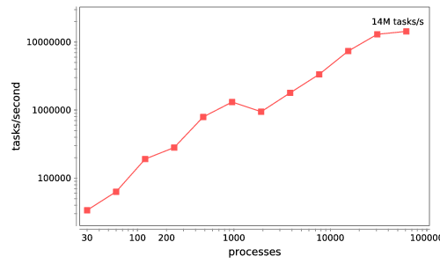




Swift/T: Enabling high-performance workflows
Write site-independent scripts
Automatic parallelization and data movement
Run native code, script fragments as applications
Rapidly subdivide large partitions for MPI jobs
Move work to data locations
Swift/T worker
Swift/T control process
Swift worker process
Swift control process
Swift control process
C
C++
Fortran
C
C++
Fortran
C
C++
Fortran
MPI
64K cores of Blue Waters
2 billion Python tasks 14 million Pythons/s

Slide 6
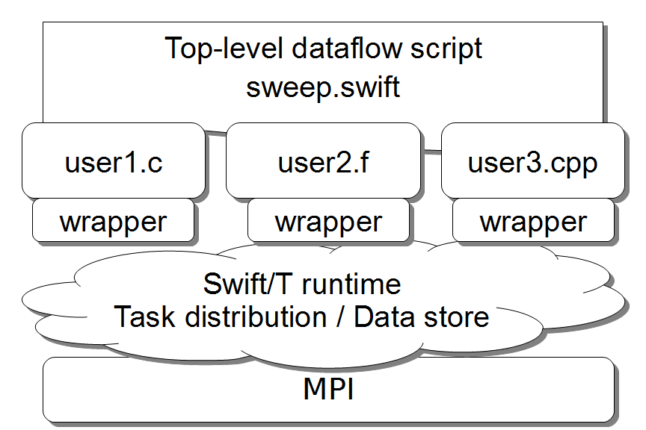
Support calls to native libraries
Including MPI libraries

Slide 7
Characteristics of very large Swift programs
int X = 100, Y = 100;
int A[][];
int B[];
foreach x in [0:X-1] {
foreach y in [0:Y-1] {
if (check(x, y)) {
A[x][y] = g(f(x), f(y));
} else {
A[x][y] = 0;
}
}
B[x] = sum(A[x]);
}
The goal is to support billion-way concurrency: O(10⁹)
Swift script logic will control trillions of variables and data dependent tasks
Need to distribute Swift logic processing over the HPC compute system

Slide 8
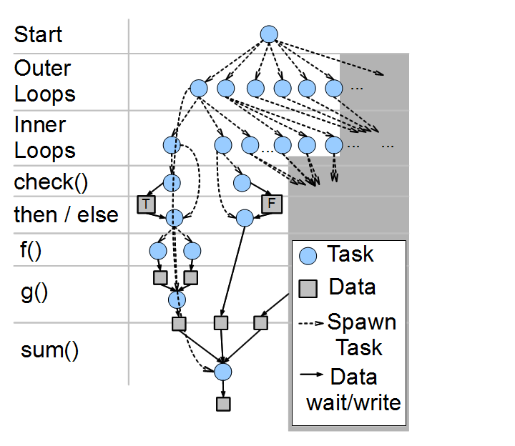
Swift/T: Fully parallel evaluation of complex scripts
int X = 100, Y = 100;
int A[][];
int B[];
foreach x in [0:X-1] {
foreach y in [0:Y-1] {
if (check(x, y)) {
A[x][y] = g(f(x), f(y));
} else {
A[x][y] = 0;
}
}
B[x] = sum(A[x]);
}

Slide 9
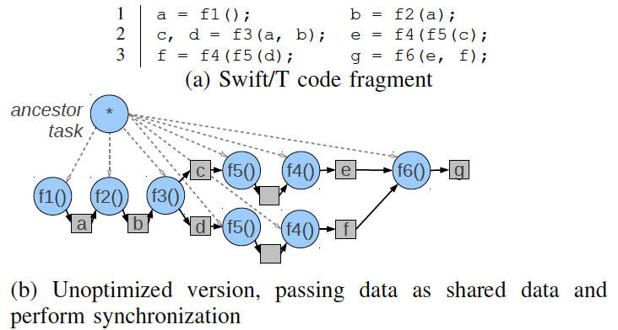
Swift/T optimization challenge: distributed vars
http://swift-lang.org

Slide 10
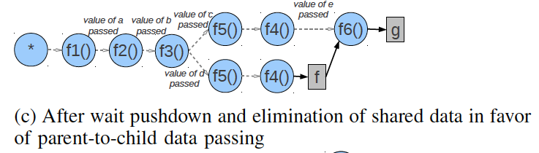
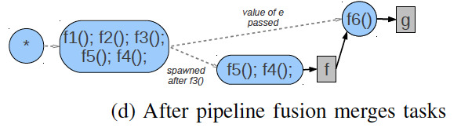
Swift/T optimizations improve data locality
http://swift-lang.org

Slide 11
Swift/T: scaling of trivial foreach { } loop 100 microsecond to 10 millisecond tasks on up to 512K integer cores of Blue Waters
http://swift-lang.org

Slide 12
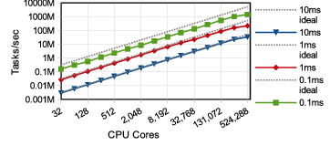
Basic scalability
1.5 billion tasks/s on 512K cores of Blue Waters, so far
Armstrong et al. Compiler techniques for massively scalable implicit task parallelism. Proc. SC 2014.

Slide 13
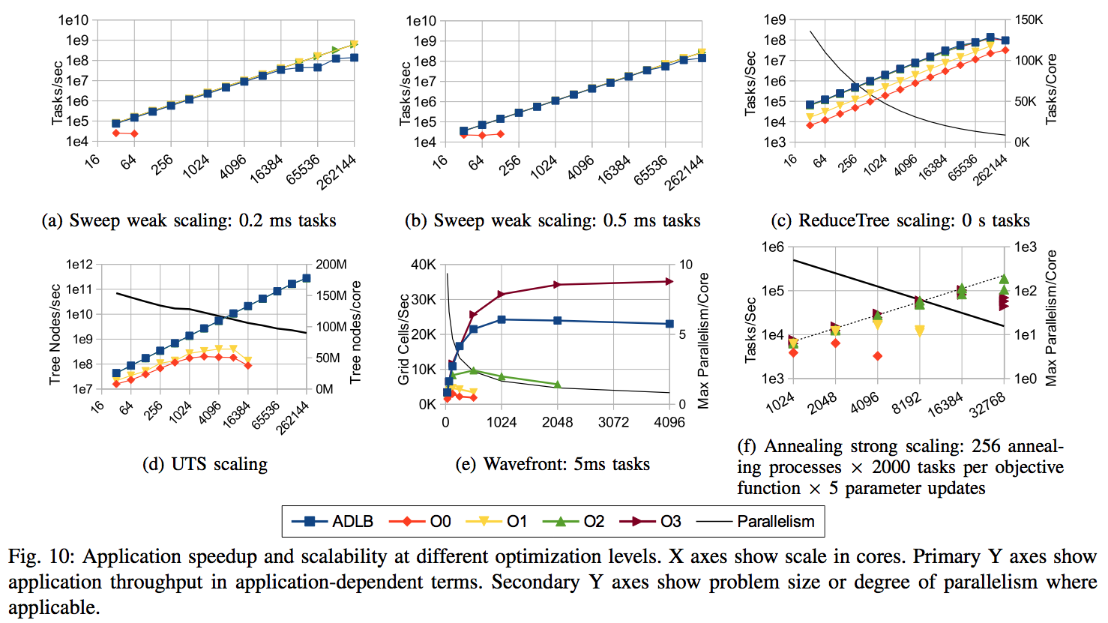
Swift/T application benchmarks on Blue Waters

Slide 14
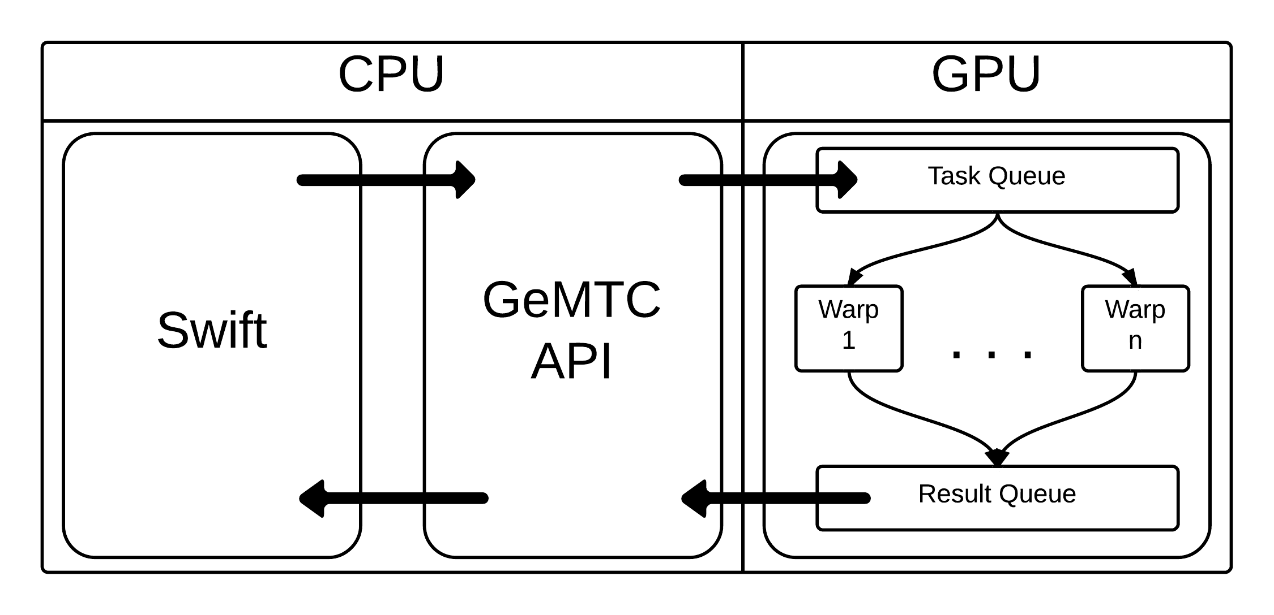
GeMTC: GPU-enabled Many-Task Computing
Motivation: Support for MTC on all accelerators!
Goals:
1) MTC support 2) Programmability
3) Efficiency 4) MPMD on SIMD
5) Increase concurrency from 15 to 192 (~13x)
Approach:
Design & implement GeMTC middleware:
1) Manages GPU 2) Spread host/device
3) Workflow system integration (with Swift/T)

Slide 15
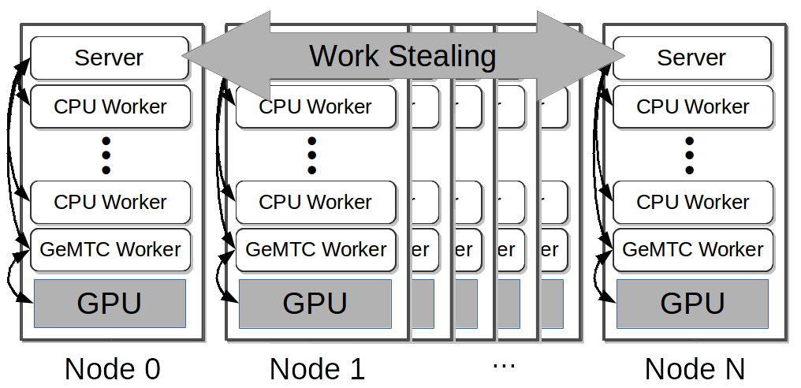
Swift/T + GeMTC Node Layout
http://swift-lang.org

Slide 16
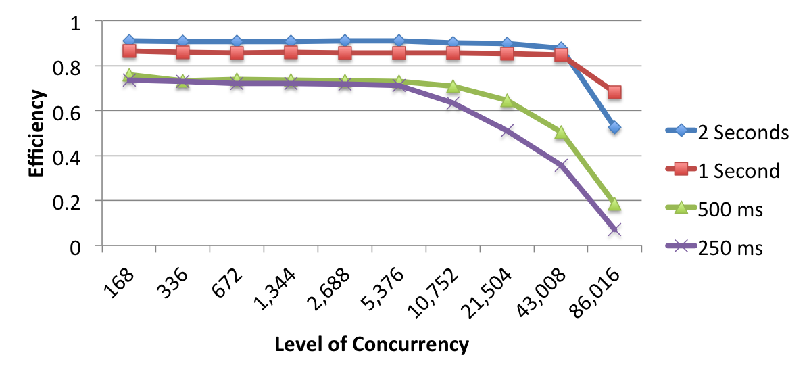
GeMTC Efficiency: 512 Nodes, 86K GPU Workers 168 active workers per GPU
http://swift-lang.org

Slide 17
Example execution
A[2] = f(getenv(“N”));
Code
Engines: evaluate dataflow operations
Workers: execute tasks
A[3] = g(A[2]);
Perform getenv()
Submit f
Subscribe to A[2]
Submit g
Notification
Task put
Task put
Process f
Store A[2]
Process g
Store A[3]
Wozniak et al. Turbine: A distributed-memory dataflow engine for high performance many-task applications. Fundamenta Informaticae 128(3), 2013

Slide 18
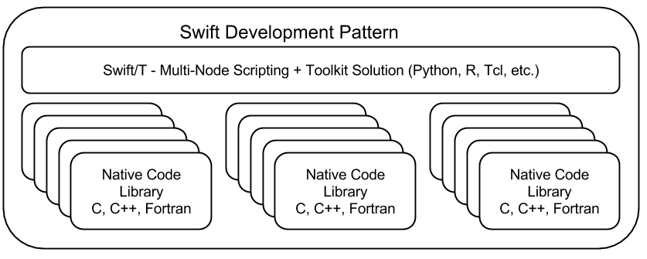
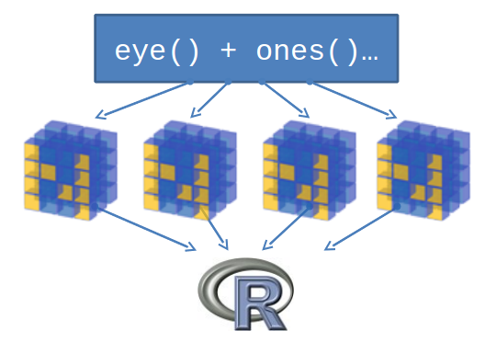
Support calls to embedded interpreters
We have plugins for Python, R, Tcl, Julia, and QtScript
Wozniak et al. Toward computational experiment management via multi-language applications. Proc. ASCR SWP4XS, 2014.

Slide 19
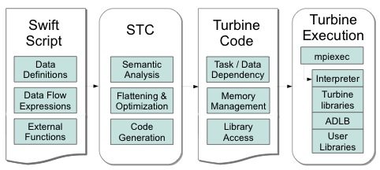
STC: The Swift-Turbine Compiler
STC translates high-level Swift expressions into low-level Turbine operations:
Create/Store/Retrieve typed data
Manage arrays
Manage data-dependent tasks
Wozniak et al. Large-scale application composition via distributed-memory data flow processing. Proc. CCGrid 2013.
Armstrong et al. Compiler techniques for massively scalable implicit task parallelism. Proc. SC 2014.

Slide 20
Logging and debugging in Swift
Traditionally, Swift programs are debugged through the log or the TUI (text user interface)
Logs were produced using normal methods, containing:
Variable names and values as set with respect to thread
Calls to Swift functions
Calls to application code
A restart log could be produced to restart a large Swift run after certain fault conditions
Methods require single Swift site: do not scale to larger runs

Slide 21
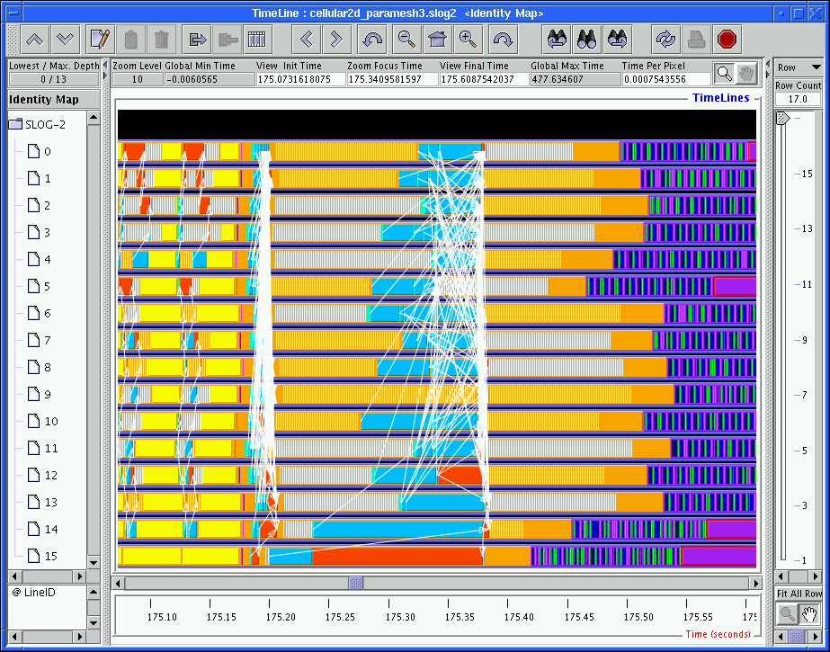
Logging in MPI
The Message Passing Environment (MPE)
Common approach to logging MPI programs
Can log MPI calls or application events – can store arbitrary data
Can visualize log with Jumpshot
Partial logs are stored at the site of each process
Written as necessary to shared file system
in large blocks
in parallel
Results are merged into a big log file (CLOG, SLOG)
Work has been done optimize the file format for various queries

Slide 22
Logging in Swift & MPI
Now, combine it together
Allows user to track down erroneous Swift program logic
Use MPE to log data, task operations, calls to native code
Use MPE metadata to annotate events for later queries
MPE cannot be used to debug native MPI programs that abort
On program abort, the MPE log is not flushed from the process-local cache
Cannot reconstruct final fatal events
MPE can be used to debug Swift application programs that abort
We finalize MPE before aborting Swift
(Does not help much when developing Swift itself)
But primary use case is non-fatal arithmetic/logic errors

Slide 23
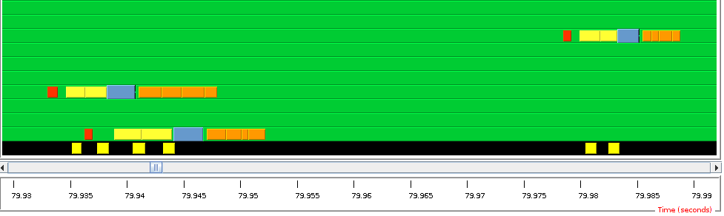
Visualization of Swift/T execution
User writes and runs Swift script
Notices that native application code is called with nonsensical inputs
Turns on MPE logging – visualizes with MPE
PIPS task computation Store variable Notification (via control task) Blue: Get next task Retrieve variable Server process (handling of control task is highlighted in yellow)
Color cluster is task transition:
Simpler than visualizing messaging pattern (which is not the user’s code!)
Represents Von Neumann computing model – load, compute, store
Process rank
Time
Jumpshot view of PIPS application run

Slide 24
Debugging Swift/T execution
Starting from GUI, user can identify erroneous task
Uses time and rank coordinates from task metadata
Can identify variables used as task inputs
Can trace provenance of those variables back in reverse dataflow
erroneous task
Aha! Found script defect.
← ← ← (searching backwards)
Wozniak et al. A model for tracing and debugging large-scale task-parallel programs with MPE. Proc. LASH-C at PPoPP, 2013.

Slide 25
Other Swift/T features
Task locality: Ability to send a task to a process
Allows for big data –type applications
Allows for stateful objects to remain resident in the workflow
location L = find_data(D); int y = @location=L f(D, x);
Task priorities: Ability to set task priority
Useful for tweaking load balancing
Updateable variables
Allow data to be modified after its initial write
Consumer tasks may receive original or updated values when they emerge from the work queue
Wozniak et al. Language features for scalable distributed-memory dataflow computing. Proc. Dataflow Execution Models at PACT, 2014.

Slide 26
Swift/T: MPI TASKS

Slide 27
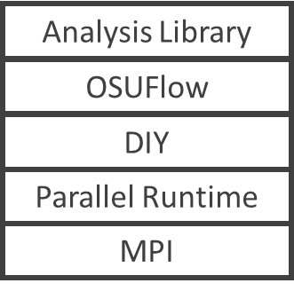
Dataflow+data-parallel analysis/visualization
Data source
Analysis Library
OSUFlow
Data source
DIY
Parallel Runtime
MPI
Dataflow-structured analysis framework
based on OSUFlow/DIY

Slide 28
Parameter optimization for data-parallel analysis: Block factor
Can map blocks to processes in varying ways

Slide 29
Parameter optimization for data-parallel analysis: Process configurations
Try all configurations to find best performance
Goal: Rapidly develop and execute sweep of MPI executions

Slide 30
Refresher: MPI_Comm_create_group()
In MPI 2, creating a subcommunicator was collective over the parent communicator
Required global coordination
Scalability concern
(Could use intercommunicator merges- somewhat slow)
In MPI 3, the new MPI_Comm_create_group() allows the implementation to assemble the new communicator quickly from a group – only group members must participate
In ADLB, servers just pass rank list for new group to workers
Motivating investigation by Dinan et al. identified fault tolerance and dynamic load balancing as key use cases – both relevant to Swift (Dinan et al., EuroMPI 2011.)

Slide 31
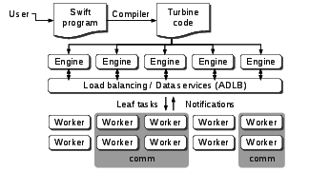
Parallel tasks in Swift/T
Swift expression: z = @par=8 f(x,y);
When x, y are stored, Turbine releases task f with parallelism=8
Performs ADLB_Put(f, parallelism=8)
Each worker performs ADLB_Get(&task, &comm)
ADLB server finds 8 available workers
Workers receive ranks from server
Perform MPI_Comm_create_group()
ADLB_Get() returns: task=f, size(comm)=8
Workers perform user task
communicate on comm
comm is released by Turbine
Wozniak et al. Dataflow coordination of data-parallel tasks via MPI 3.0. Proc EuroMPI, 2013.

Slide 32
OSUFlow application
// Define call to OSUFlow feature MpiDraw
@par (float t) mpidraw(int bf) "mpidraw";
main {
foreach b in [0:7] {
// Block factor: 1-128
bf = round(2**b);
foreach n in [4:9] {
// Number of processes/task: 16-512
np = round(2**n);
t = @par=np mpidraw(bf);
printf("RESULT: bf=%i np=%i -> time=%0.3f",
bf, np, t);
}}}

Slide 33
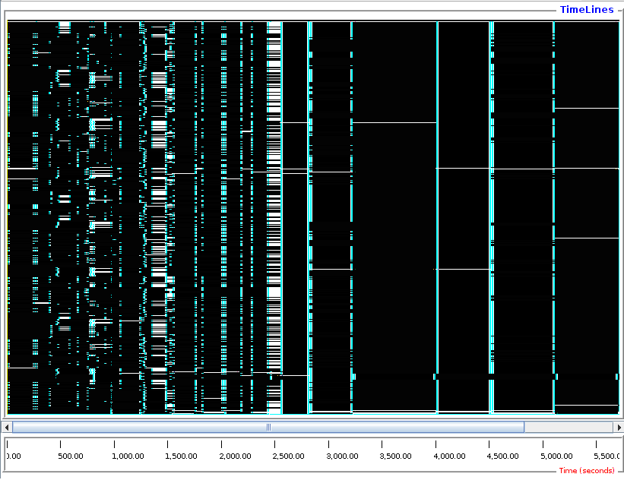
Times from 222s (blue) to 948 (red)
Best results (fastest times) at np=256, high block parameter

Slide 34
Swift/T APPLICATIONS

Slide 35
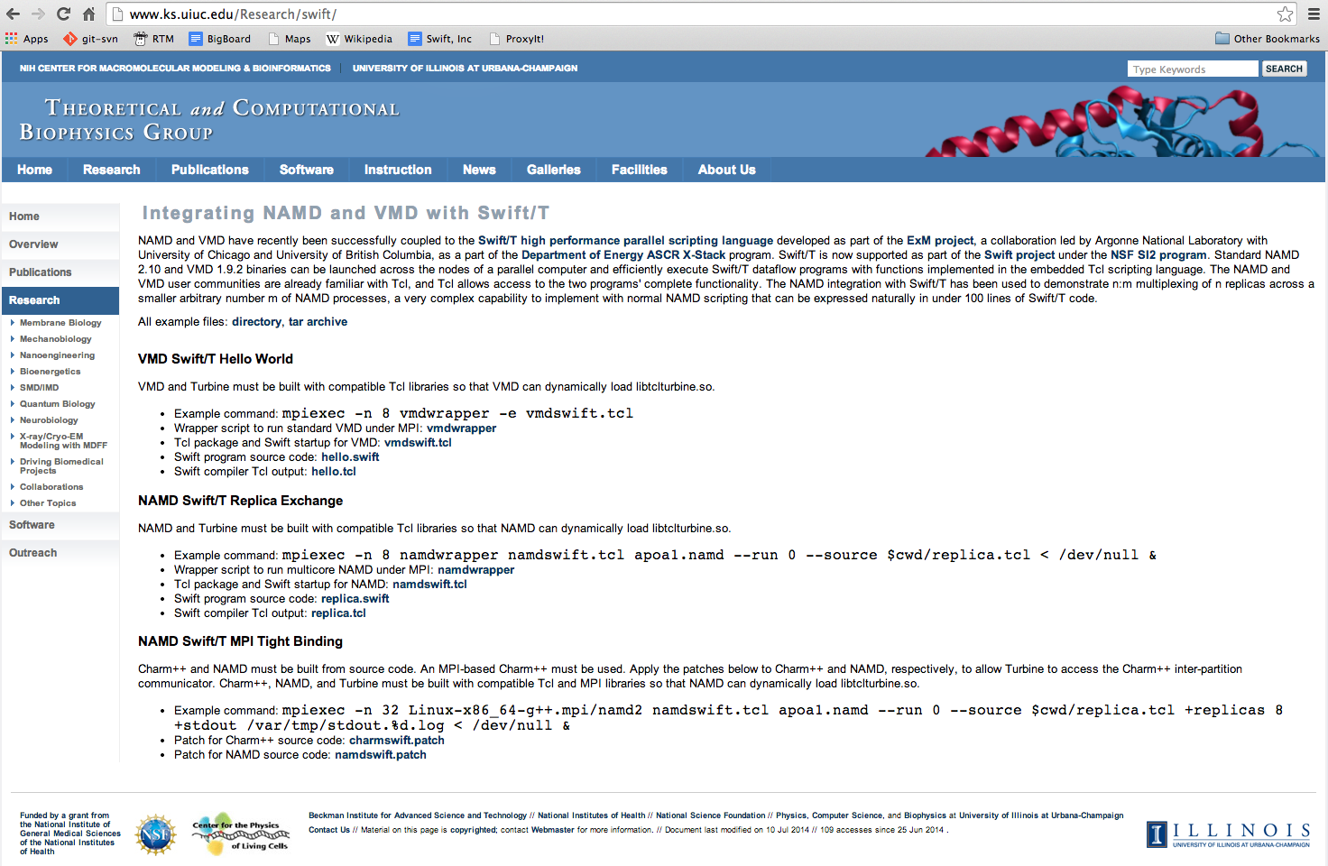
Swift integration into NAMD and VMD
www.ks.uiuc.edu/Research/swift

Slide 36
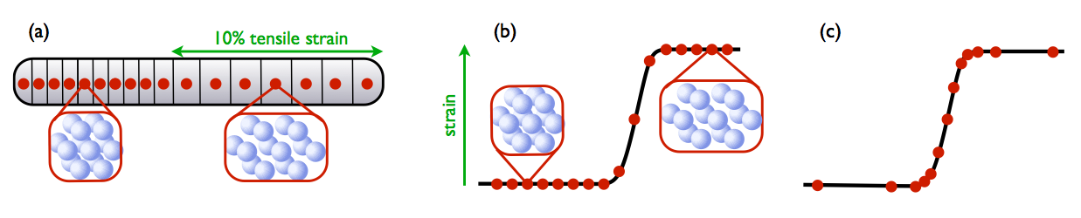
ExMatEx: Co-design for materials research
CoHMM: Heterogeneous Multiscale Method
CoMD: Molecular Dynamics
Coarse-grain strain evolution using basic conservation laws
Fine-grain molecular dynamics as necessary for physical coefficients
From http://www.exmatex.org

Slide 37
CoHMM/Swift
300 lines of sequential C
Coordinates multiple sequential calls to CoMD
We rewrote this in Swift
CoHMM
CoMD
CoMD
CoMD
1000’s lines of sequential C
Simplified MD simulator
Typically called as standalone program
We exposed CoMD as a Swift function – no exec()
Concurrency gained primarily by calls to CoMD

Slide 38
CoMD: Library access from Swift
CoMD binding: (example-1) string s = "-f data/8k.inp.gz"; int N = 3; foreach i in [0:N-1] {
float virial_stress = COMDSWIFT_runSim(s);
printf("Swift: virial_stress: %e", virial_stress);
}

Slide 39
CoMD: Library access from CoHMM
C #define ZERO_TEMP_COMD "../../CoMD/CoMD -x 6 -y 6 -z 6" #ifdef ZERO_TEMP_COMD
// open pipe to CoMD
FILE *fPipe = popen(ZERO_TEMP_COMD,"r");
if (fPipe == NULL) { …
Swift #define ZERO_TEMP_COMD "../../CoMD/CoMD -x 6 -y 6 -z 6"
#ifdef ZERO_TEMP_COMD
string command = ZERO_TEMP_COMD;
stressXX = COMDSWIFT_runSim(command);
#else
// Just the derivative of the zero temp energy wrt A
stressXX = rho0*c*c*(A-1);
#endif

Slide 40
CoHMM: Translation from C to Swift: main()
C int main(int argc, char **argv) { initializedConservedFields();
for (i = 0; i < 100; i++) {
for (j = 0; j < 1; j++)
fullStep();
Swift main { (A[0], p[0], e[0]) = initializedConservedFields();
for (int t = 0; t < 5; t = t+1) {
(A[t+1], p[t+1], e[t+1]) = fullStep(A[t], p[t], e[t]);

Slide 41
CoHMM: Translation from C to Swift: call CoMD
C void fluxes(double *A, double *p, double *e, double *f_A, double *f_p, double *f_e) {
for (int i = 0; i < L; i++) {
double stress = stressFn(A[i], e[i]);
double v = p[i] / rho0; f_A[i] = -v;
f_p[i] = -stress;
f_e[i] = -stress*v;
Swift (float f_A[], float f_p[], float f_e[])
fluxes(float A[], float p[], float e[]) {
foreach i in [0:L-1] {
float stress = stressFn(A[i], e[i]);
float v = p[i] / rho0; f_A[i] = -v;
f_p[i] = -stress;
f_e[i] = -stress*v;

Slide 42
Can we build a Makefile in Swift?
User wants to test a variety of compiler optimizations
Compile set of codes under wide range of possible configurations
Run each compiled code to obtain performance numbers
Run this at large scale on a supercomputer (Cray XE6)
In Make you say: CFLAGS = ... f.o : f.c gcc $(CFLAGS) f.c -o f.o In Swift you say: string cflags[] = ...; f_o = gcc(f_c, cflags);

Slide 43
CHEW example code
Apps app (object_file o) gcc(c_file c, string cflags[]) {
// Example:
// gcc -c -O2 -o f.o f.c
"gcc" "-c" cflags "-o" o c;
}
app (x_file x) ld(object_file o[], string ldflags[]) {
// Example:
// gcc -o f.x f1.o f2.o ...
"gcc" ldflags "-o" x o;
}
app (output_file o) run(x_file x) {
"sh" "-c" x @stdout=o;
}
app (timing_file t) extract(output_file o) {
"tail" "-1" o "|" "cut" "-f" "2" "-d" " " @stdout=t;
}
Swift code
string program_name = "programs/program1.c";
c_file c = input(program_name);
// For each
foreach O_level in [0:3] {
make file names…
// Construct compiler flags
string O_flag = sprintf("-O%i", O_level);
string cflags[] = [ "-fPIC", O_flag ];
object_file o<my_object> = gcc(c, cflags);
object_file objects[] = [ o ];
string ldflags[] = [];
// Link the program
x_file x<my_executable> = ld(objects, ldflags);
// Run the program
output_file out<my_output> = run(x);
// Extract the run time from the program output
timing_file t<my_time> = extract(out);

Slide 44
Swift Use of GPUs
GeMTC: GPU-enabled Many-Task Computing
Approach:
1) Deploy kernel to manage GPU warps 2) Manage memory 3) Integrate with workflow system (Swift/T)
Krieder et al. Evaluation of Many-Task Computing on Accelerators for High-End Systems. Proc. HPDC 2014.

Slide 45
Discovery engines LDRD: Workflows

Slide 46
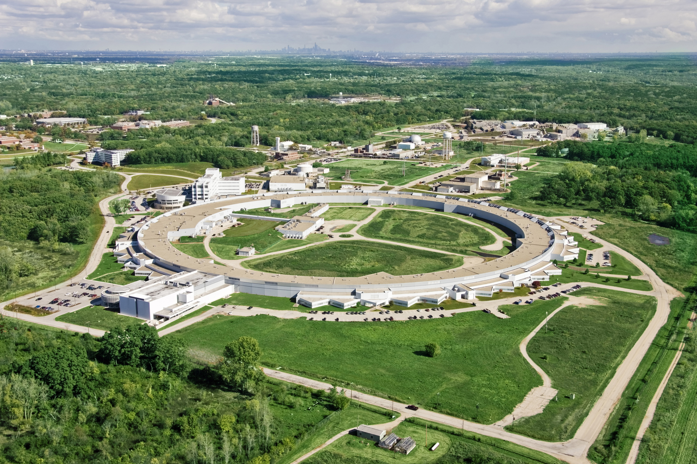
Advanced Photon Source (APS)

Slide 47
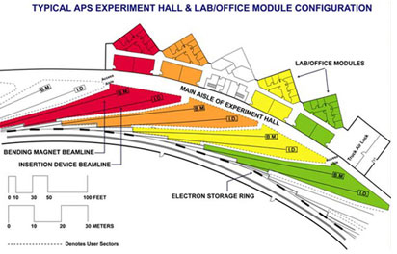
Advanced Photon Source (APS)
Moves electrons at electrons at >99.999999% of the speed of light.
Magnets bend electron trajectories, producing x-rays, highly focused onto a small area
X-rays strike targets in 35 different laboratories – each a lead-lined, radiation-proof experiment station

Slide 48
Data management for the energy sciences
“Despite the central role of digital data in Dept. of Energy (DOE) research, the methods used to manage these data and to support the information and collaboration processes that underpin DOE research are often surprisingly primitive…” - DOE Workshop Report on Scientific Collaborations (2011)
Our goals:
Modify the operating systems of APS stations to allow real-time streaming to a novel data storage/analysis platform.
Converting data from the standard detector formats (usually TIFF) to HDF5 and adding metadata and provenance, based on the NeXus data format.
Rewrite analysis operations to work in a massively parallel environment.
Scale up simulation codes that complement analysis.

Slide 49
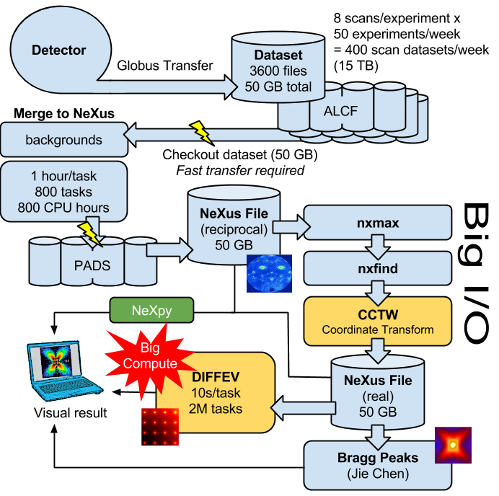
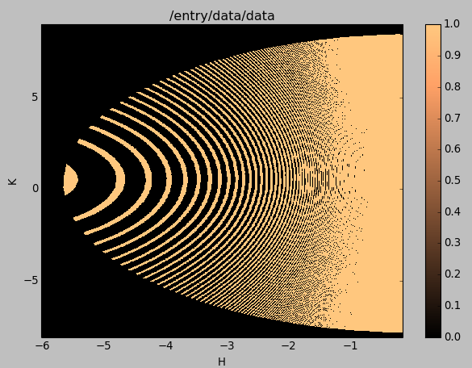
Data ingest/analysis/archive
The October run produced 104 directories containing 5M files totaling about 27 TB.

Slide 50

PADS: Petascale Active Data Store
23 higher-end nodes for data-intensive computing, repurposed for this work (installed in 2009)
Each node has 12-way RAID for very fast local disk operations
Previously, difficult to use as “Active Data Store”
Difficult to access specific nodes through PBS scheduler
No catalog (where is my data?)
No way to organize/access Data Store!
Solution: Swift/T
Organizes distributed data using Swift data structures and mappers
Leaves data on nodes for later access
Allows for targeted tasks (can send work to node with data chunk)
Integrates with Globus Catalog for metadata, provenance, archive...
Combining unscheduled resource access with high performance data rates will allow for real-time beamline data analysis, accelerating progress for materials science efforts

Slide 51
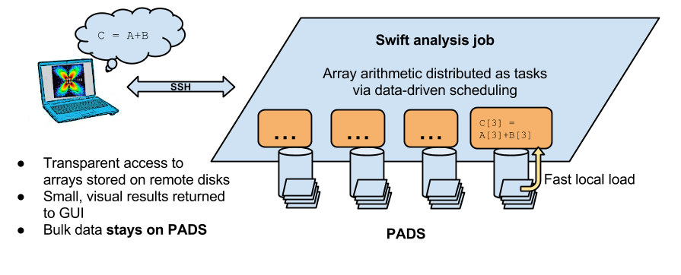
Interactive analysis powered by scalable storage
Replace GUI analysis internals with operations on remote data

Slide 52
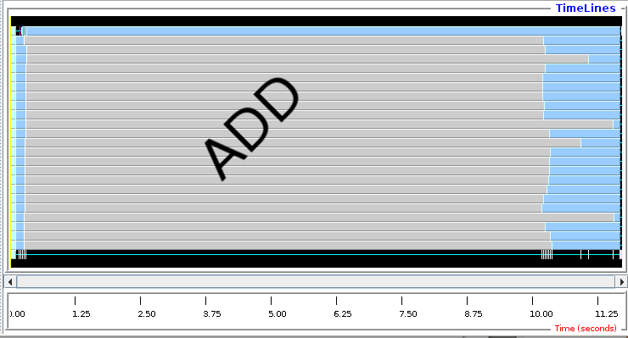
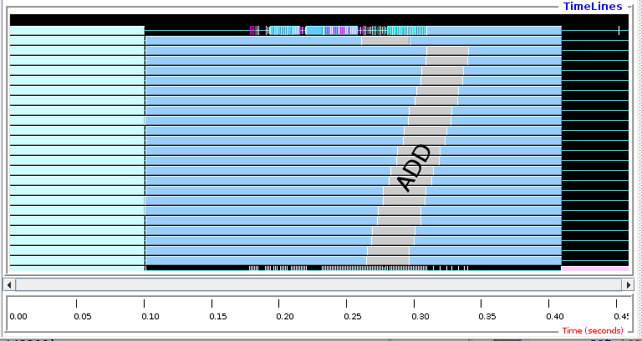
Remote matrix arithmetic: Initial results
Initial run shows performance issue: addition took too long
Swift profiling isolated issue: convert addition routine from script to C function: obtained 10,000 X speedup
Swift/T integrates with MPE/Jumpshot and other MPI-based performance analysis techniques

Slide 53
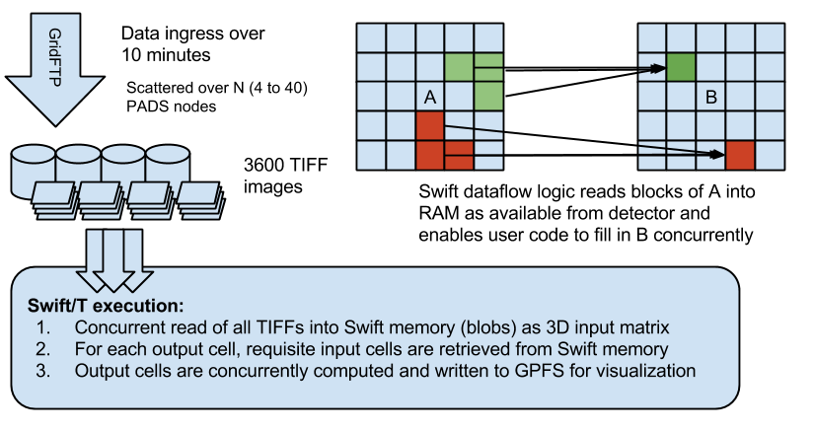
Crystal Coordinate Transformation Workflow
MapReduce-like pattern expressed elegantly in Swift

Slide 54
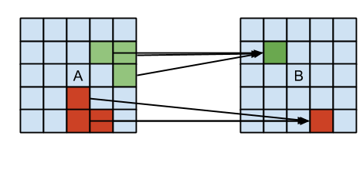
CCTW: Swift/T application (C++)
bag<blob> M[];
foreach i in [1:n] {
blob b1= cctw_input(“pznpt.nxs”);
blob b2[];
int outputId[];
(outputId, b2) = cctw_transform(i, b1); foreach b, j in b2 {
int slot = outputId[j];
M[slot] += b;
}}
foreach g in M {
blob b = cctw_merge(g); cctw_write(b);
}}

Slide 55
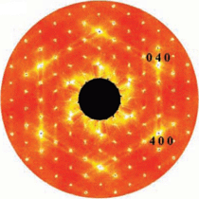
Diffuse scattering and crystal analysis
DISCUS is a general program to generate disordered atomic structures and compute the corresponding experimental data such as single crystal diffuse scattering (http://discus.sourceforge.net)
Given experimental data, can we fit a modeled crystal to the measurement?
Experimental image: (Billinge, 2006)

Slide 56
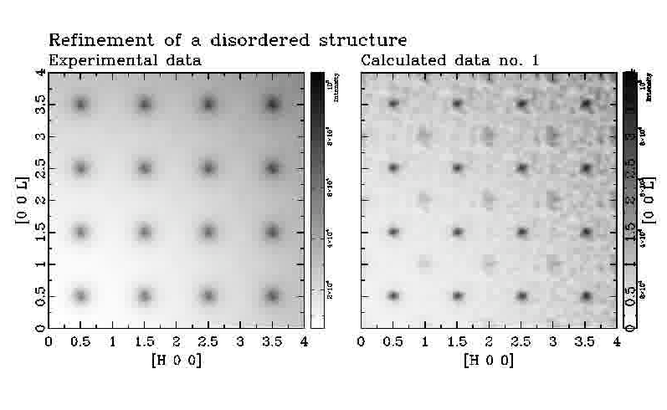
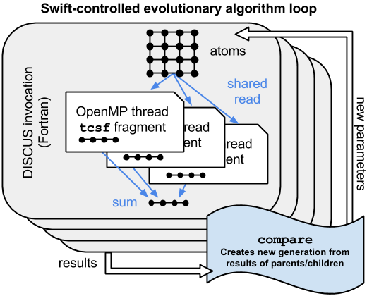
DIFFEV: Scaling crystal diffraction simulation
Determines crystal configuration that produced given scattering image through simulation and evolutionary algorithm
Swift/T calls DISCUS via Python interfaces

Slide 57
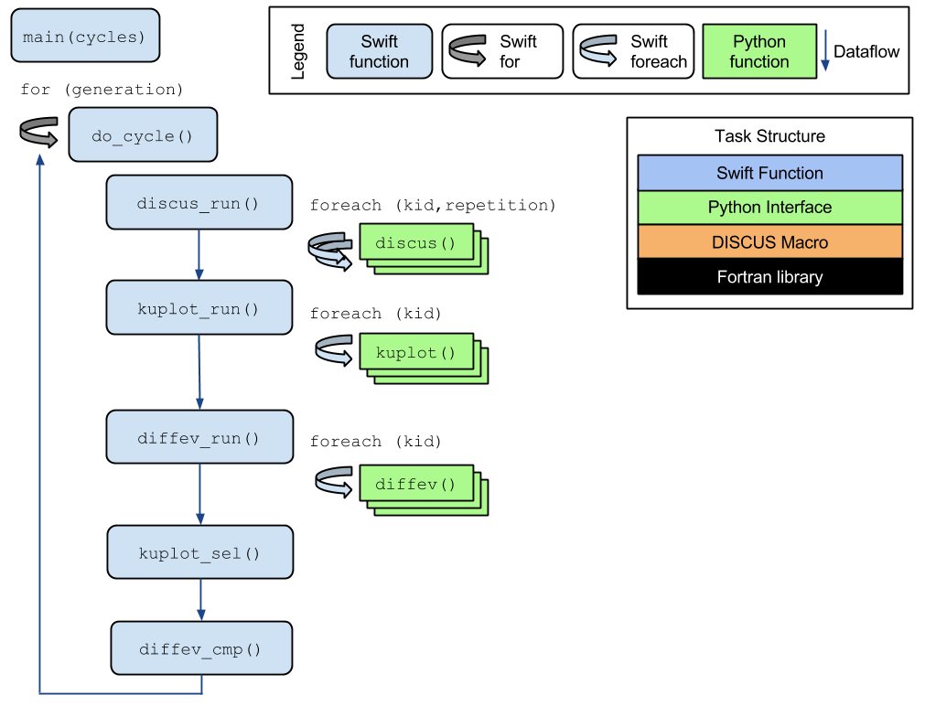
DIFFEV: Genetic algorithm via dataflow
Novel application composed from existing libraries by domain expert!
Potential concurrency: 100,000 cores
Application by Reinhard Neder

Slide 58
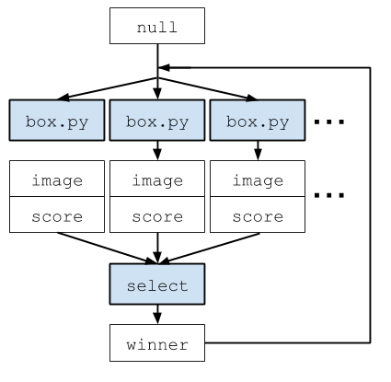
R. Harder workflow: Genetic algorithm
individuals = toint(argv("individuals"));
ngenerations = toint(argv("ngenerations"));
file winners[];
winners[0] = input(“null.winner");
for (int generation = 1; generation < ngenerations;
generation = generation+1) {
file population[];
foreach box_index in [0:individuals-1] {
file d<sprintf("d-%i-%i.out",generation,box_index)>;
file s<sprintf("d-%i-%i.score",generation,box_index)>;
(d,s) = box(box_index, generation, winners[generation-1]);
population[box_index] = d;
}
file winner_file<sprintf("d-%i.winner", generation)> =
select(generation, population);
winners[generation] = winner_file;
}}

Slide 59
High-Energy Diffraction Microscopy
Near-field high-energy diffraction microscopy discovers metal grain shapes and structures
The experimental results are greatly improved with the application of Swift-based cluster computing (RED indicates higher confidence in results)
October 2013: Without Swift
April 2014: With Swift

Slide 60
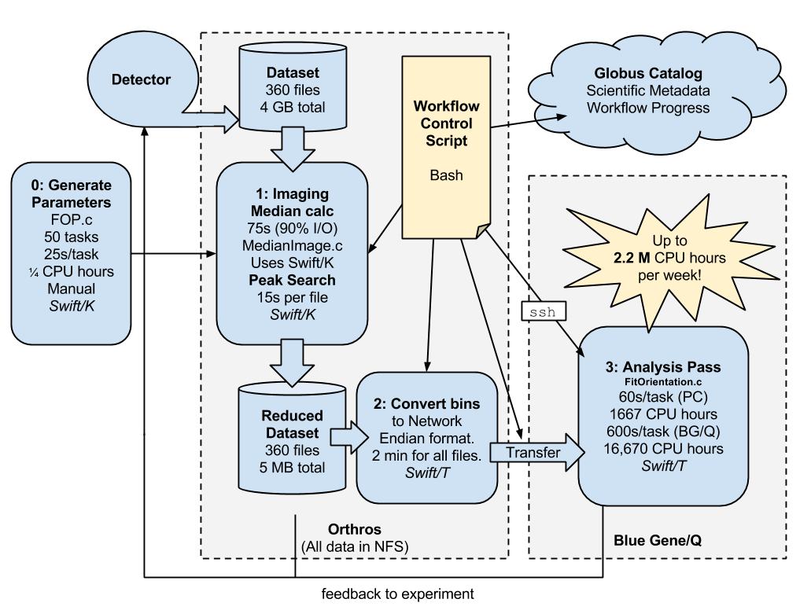
NF-HEDM: Cross-lab workflow

Slide 61
Future work

Slide 62
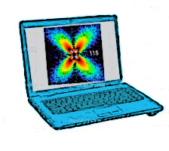
Extreme scale application ensembles
Develop Swift for exascale experiment ensembles
Deploy stateful, varying sized jobs
Outermost, experiment-level coordination via dataflow
Plug in experiments and human-in-the-loop models (dataflow filters)
APS
Big job 1: Type A
Big job 2: Type A
Big job 3: Type B
Small job 1: Type A
Small job 2: Type A
Small job 3: Type B
Small job 4: Type B
Small job 4: Type C
Small job 5: Type D

Slide 63
Future Work
Develop Swift for exascale
Continue scaling work: Study distributed dataflow for realistic patterns
Ease integration with native code
Application collaborations
Materials science: APS (Osborn, Sharma)
Molecular dynamics: NAMD (Phillips), LAMMPS (Whitmer)
Connect with novel systems elsewhere in MCS, ALCF:
Memcached (Isaila et al.)
Tess (Peterka et al.)
Filesystems (Ross et al.)
Connect with new applications at the CI and elsewhere!

Slide 64
Summary
Swift: High-level scripting for outermost programming constructs
Handles many aspects of the scientific computing experience
Described how dataflow logic is distributed
New features for parallel tasks
Thanks to the Swift team: Mike Wilde, Ketan Maheshwari, Tim Armstrong, David Kelly, Yadu Nand, Mihael Hategan, Scott Krieder, Ioan Raicu, Dan Katz, Ian Foster
Thanks to project collaborators: Tom Peterka, Jim Dinan, Ray Osborn, Reinhard Neder, Guy Jennings, Hemant Sharma, Rachana Ananthakrishnan, Ben Blaiszik, Kyle Chard, Tim Germann, and others
Questions?
THINK
RUN
IMPROVE
COLLECT

